Slide 1
3D Millimeter-Wave Gesture Localization for Wall-Based Interactive System 基於3D毫米波手勢定位的牆面互動系統
Presenter: Han-Yang Lin 林翰暘
Tel: 0988-203713
E-mail: chipie2416@gmail.com
Advisor: Prof. Chiou-Shann Fuh 傅楸善

Slide 2
Outline
Introduction
Related Works
Background
Methodology
Experimental Results
Conclusion and Future Works
References

Slide 3
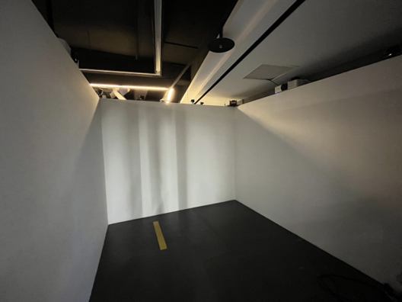
Introduction
Stand in front of the wall and wave the hand to interact with the applications
Touch screen
Mimic mouse functionality
Utilize gesture localization techniques to achieve cursor control
Track the precise position of the hand in three-dimensional space

Slide 4
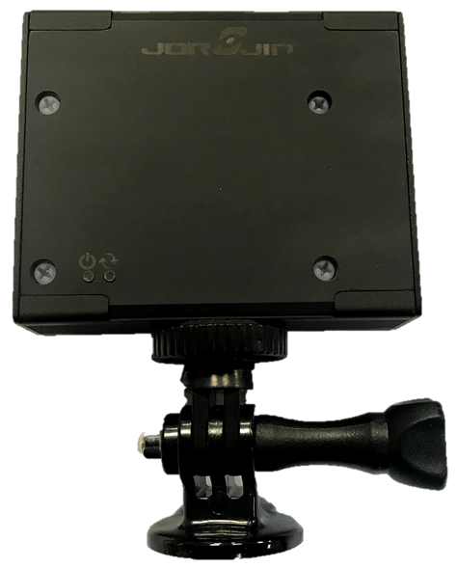
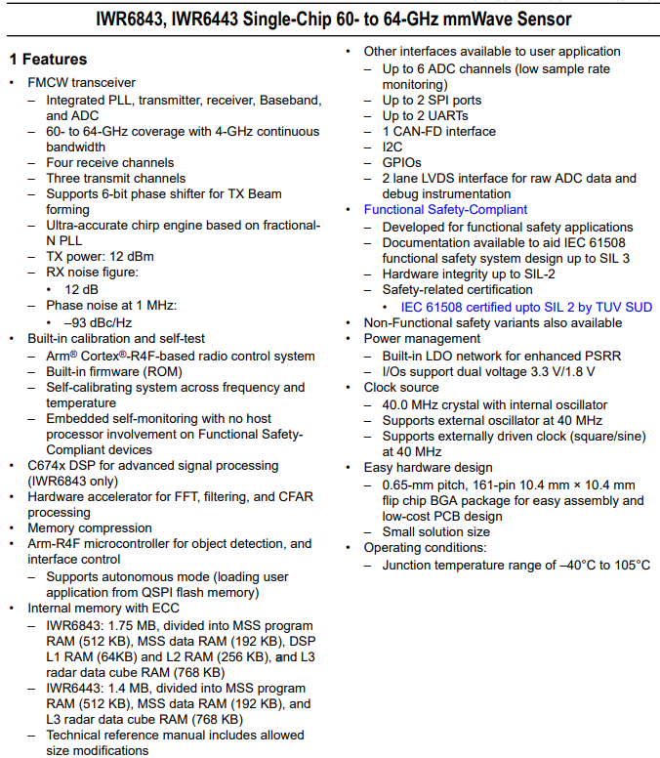
Introduction
Texas Instrument IWR6843 MMWave sensor
(~NT$ 8,378)
Industrial sensors for measuring range, speed, and angle
Based on Doppler effect
Position sensing
People counting

Slide 5
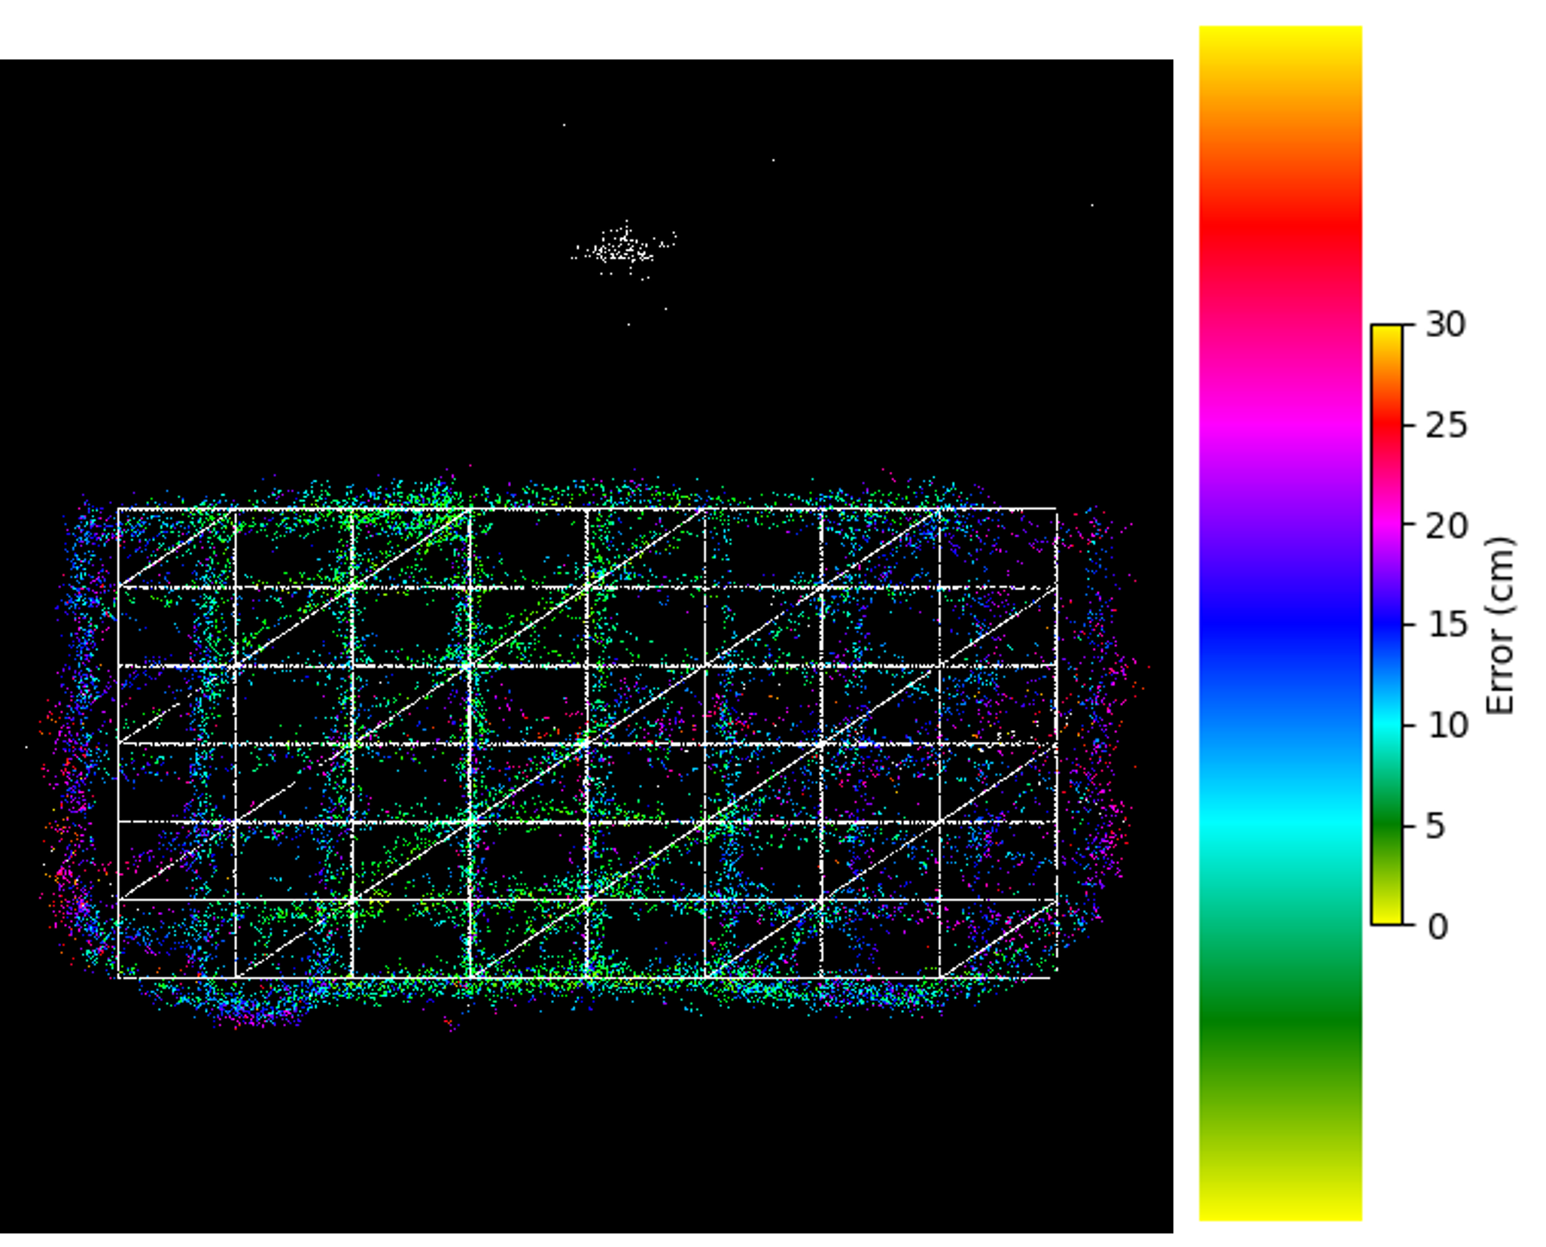
Introduction
Point Cloud
Directly leveraging the raw point cloud data generated by the millimeter-wave radar
Fan-shaped distortion
Reference People Counting mmWave
Our mmWave
Notes:
點雲 直接利用毫米波雷達產生的原始點雲資料 扇形畸變
每顆毫米波都有強區弱區
如何證明水平：
固定的擺設，有對準牆面投影格線

Slide 6
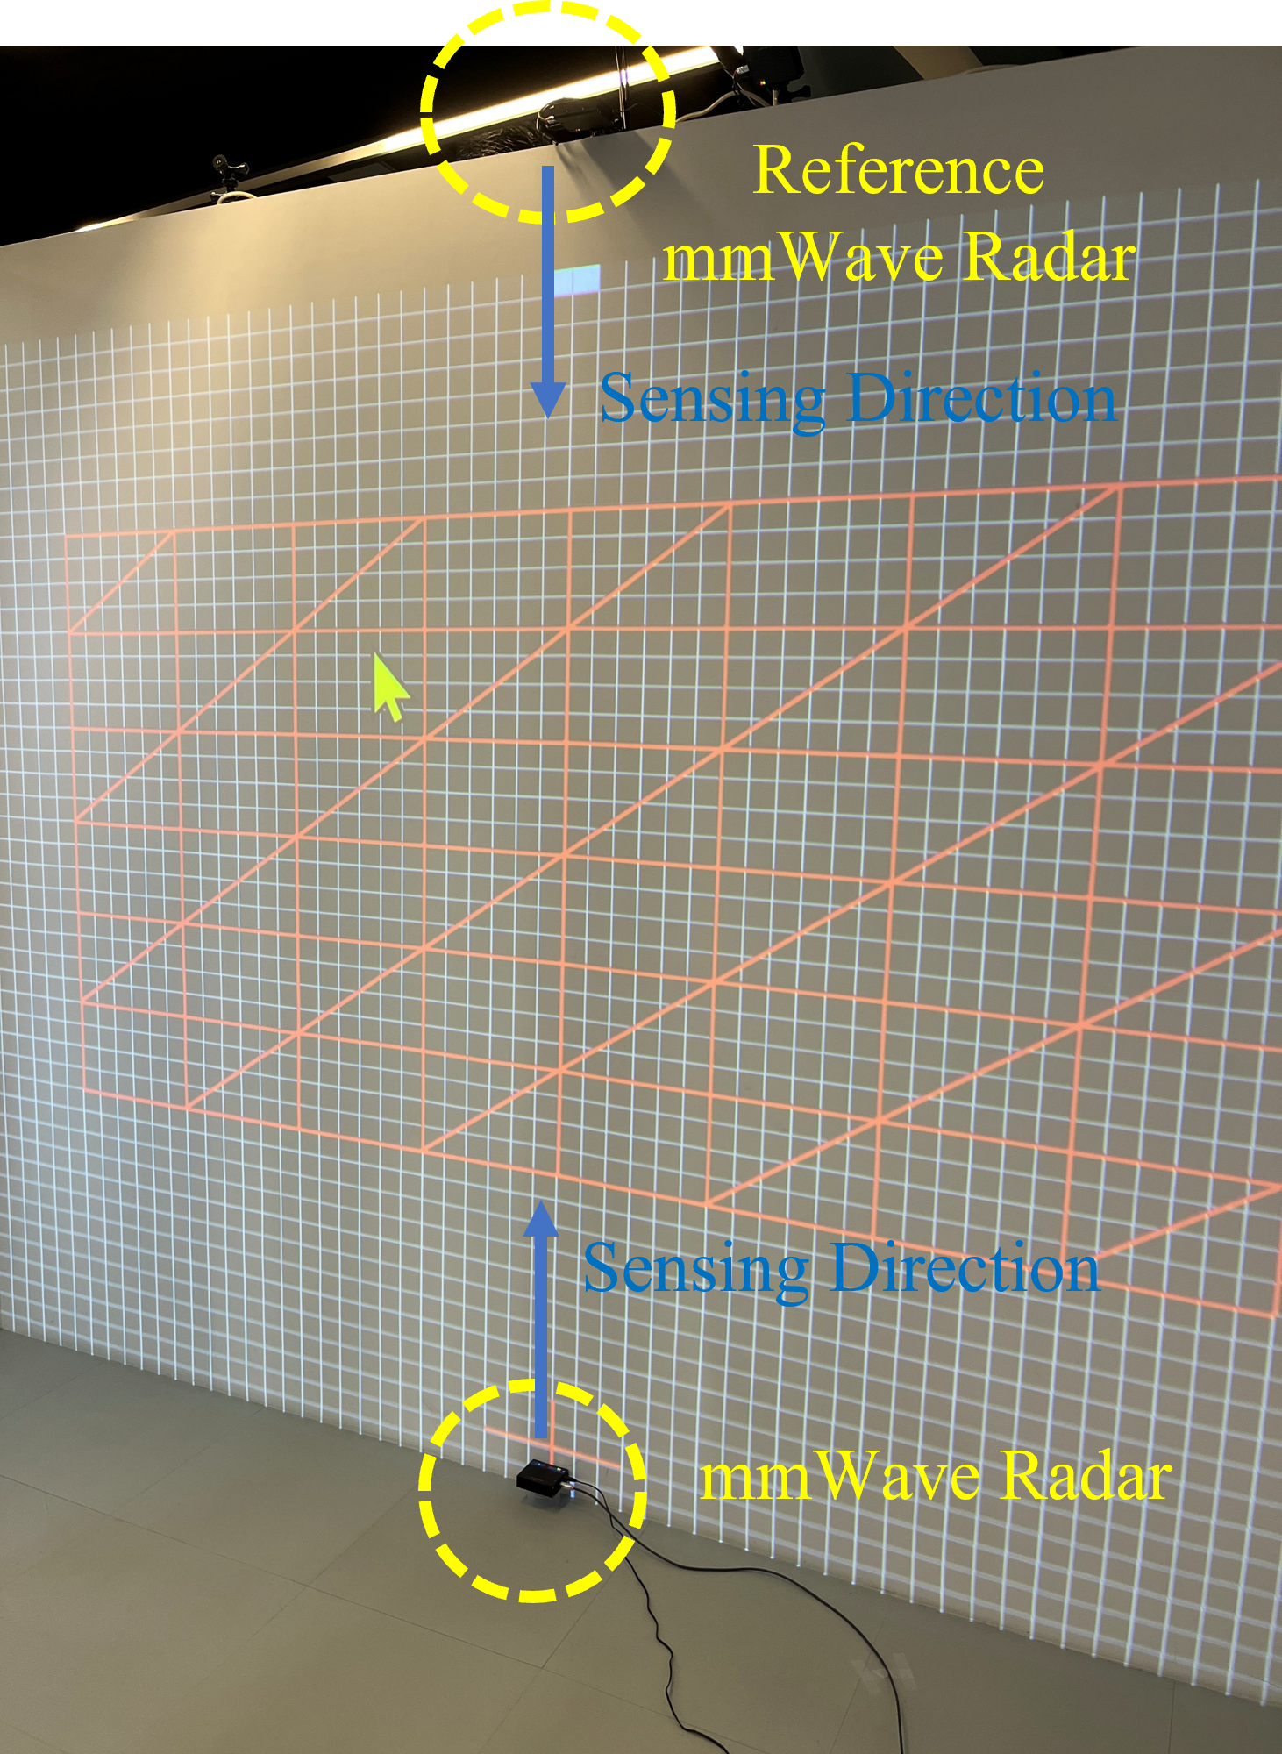
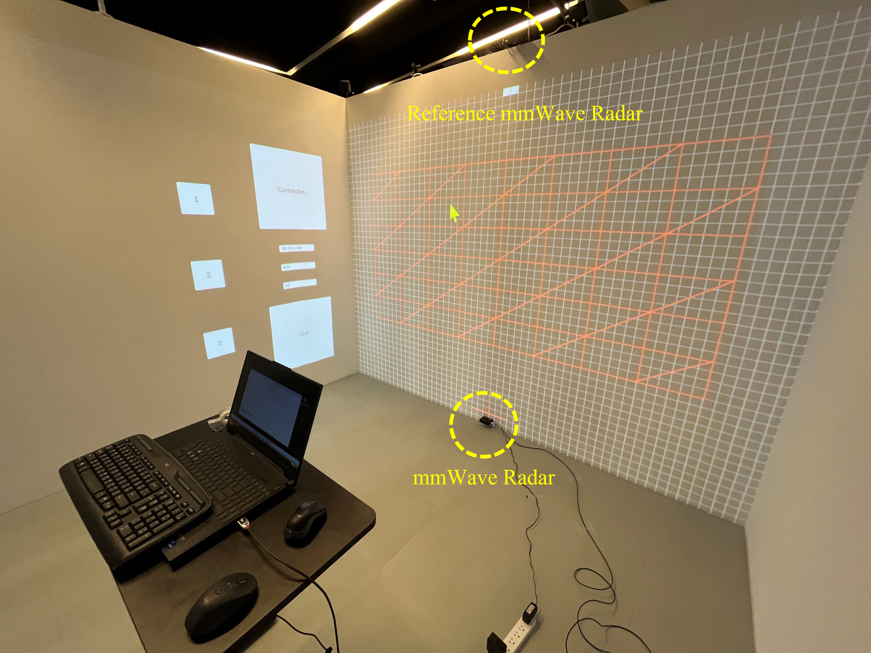
Introduction

Slide 7
Related Works
Interactive Wall Systems
Millimeter-Wave Radar Human Sensing

Slide 8
Interactive Wall Systems
Camera-based interactive wall display system (Zahra et al., 2023)
Otsu thresholding and Genetic Algorithms to determine the correctness of gestures and execute corresponding actions
Interactive media wall incorporating hand gesture recognition
(Hong et al., 2024)
Use the Unity 3D engine and MediaPipe's hand pose estimation model for gesture recognition

Slide 9
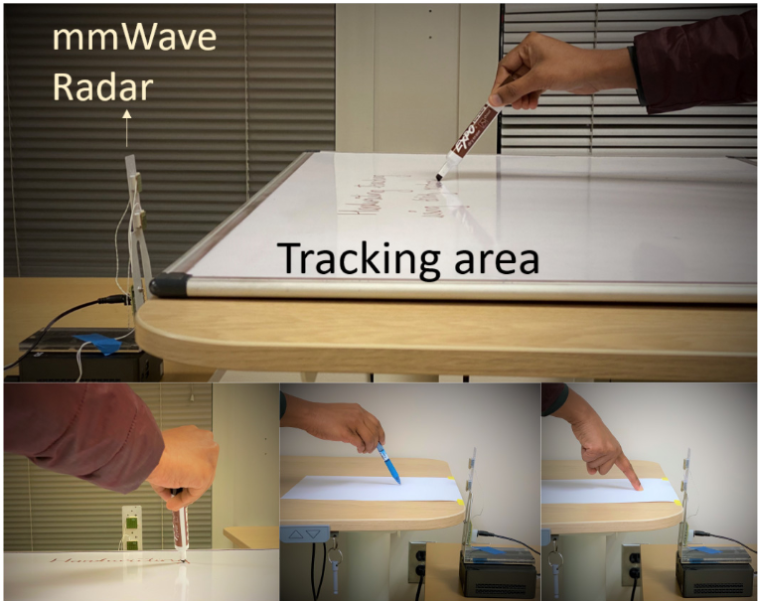
Millimeter-Wave Radar Human Sensing
mmWrite (Regani et al., 2021)
Employ a robust signal processing pipeline to directly track the motion of writing objects

Slide 10
Millimeter-Wave Radar Human Sensing
Pantomime (Palipana et al., 2021)
Leverage the spatio-temporal properties of millimeter-wave radar signals to achieve efficient gesture recognition
95% accuracy outperforms state-of-the-art 3D point cloud recognizer

Slide 11
Background
Point Cloud Clustering
DBSCAN: Density-Based Spatial Clustering of Applications with Noise
HDBSCAN: Hierarchical DBSCAN
Multiple Object Tracking
Kalman Filter
Hungarian algorithm

Slide 12
Point Cloud Clustering
DBSCAN
Density-Based Spatial Clustering of Applications with Noise
HDBSCAN
Hierarchical DBSCAN

Slide 13
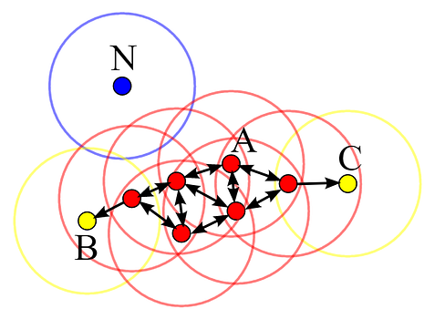
Point Cloud Clustering - DBSCAN
Emphasize density in the data
Capable of automatically handling noise
Determine the final number of clusters based on the nature of the data
eps: neighborhood radius
min_samples: 4
A: Core
B, C: not core
N: noise

Slide 14
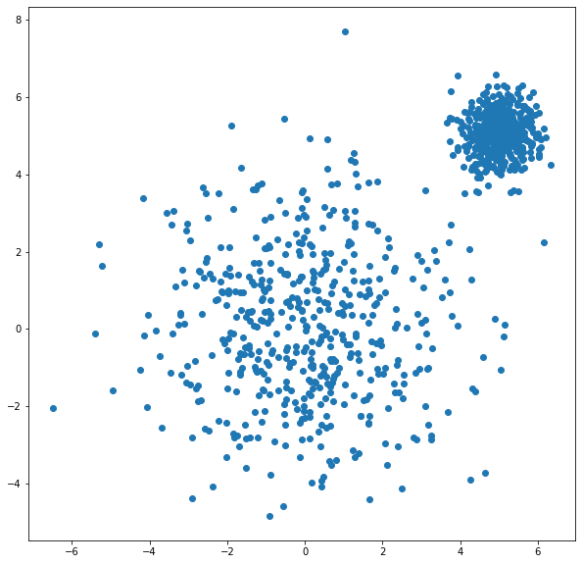
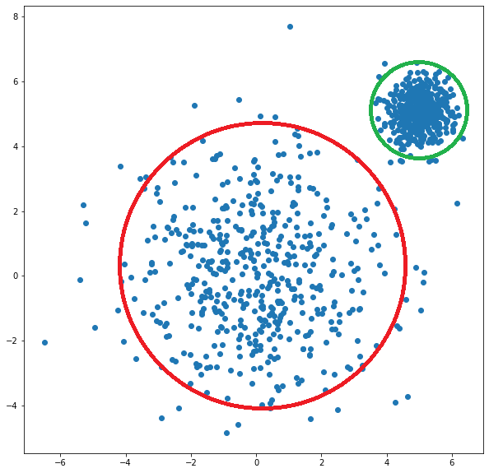
Point Cloud Clustering - DBSCAN
Notes:
對參數敏感

Slide 15
Point Cloud Clustering - HDBSCAN
Hierarchical DBSCAN
Not limited by DBSCAN's restrictions on cluster density
Parameters
min_samples
min_cluster_size
This is from the H part of HDBSCAN
Notes:
https://stackoverflow.com/questions/67898039/hdbscan-difference-between-parameters
min_samples = the minimum number of neighbours to a core point.
The higher this is, the more points are going to be discarded as noise/outliers. This is from DBScan part of HDBScan.
min_cluster_size = the minimum size a final cluster can be.
The higher this is, the bigger your clusters will be. This is from the H part of HDBScan.

Slide 16
Point Cloud Clustering - HDBSCAN
Use mutual reachability distance to construct a minimum spanning tree
Hierarchical clustering using single linkage
Condensed tree and stability-based cluster selection
Notes:
https://stackoverflow.com/questions/67898039/hdbscan-difference-between-parameters
min_samples = the minimum number of neighbours to a core point.
The higher this is, the more points are going to be discarded as noise/outliers. This is from DBScan part of HDBScan.
min_cluster_size = the minimum size a final cluster can be.
The higher this is, the bigger your clusters will be. This is from the H part of HDBScan.

Slide 17
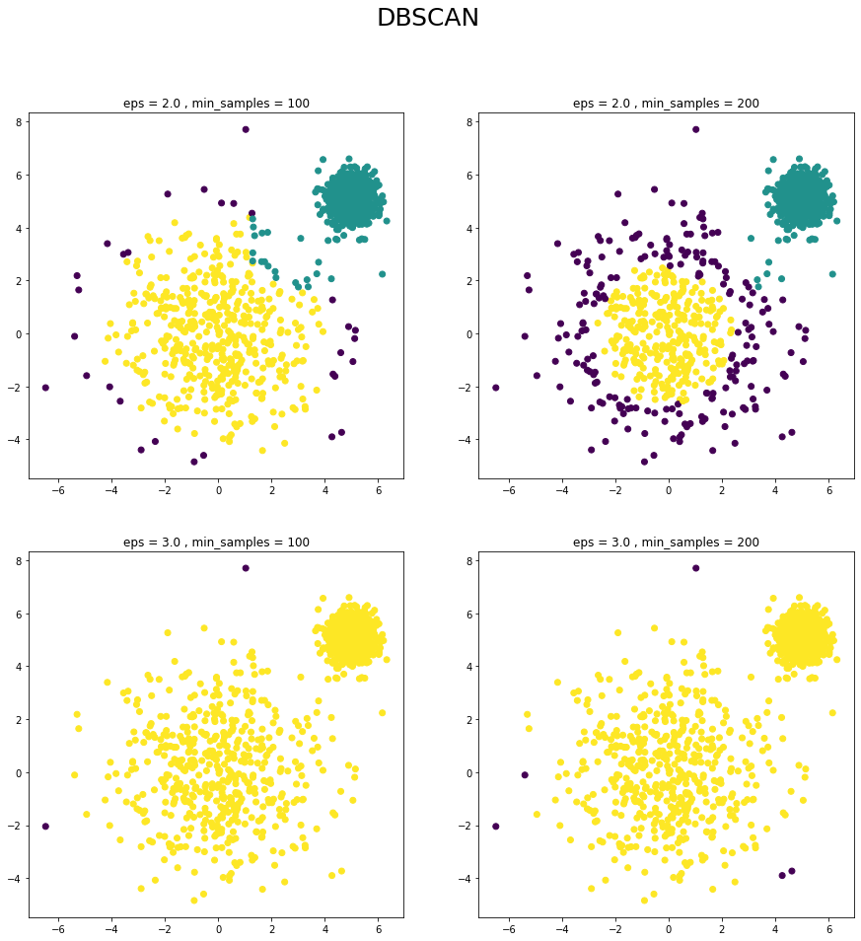
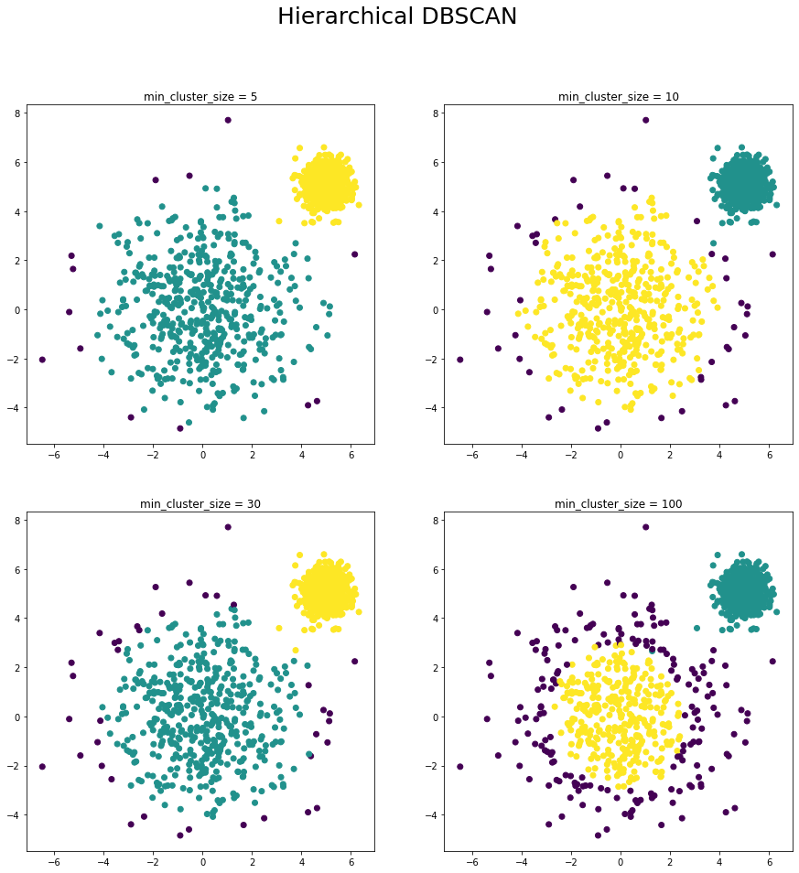
Point Cloud Clustering
Dark Blue: Noise
Green: Cluster 1
Yellow: Cluster 2
DBSCAN vs. HDBSCAN

Slide 18
Multiple Object Tracking – Kalman Filter
A recursive algorithm that estimates the state of a system from noisy measurements
Two main phases
Prediction phase: Estimates current state (hand weighted center position after clustering) and uncertainties
Update phase: Refines estimates using new measurements

Slide 19
Multiple Object Tracking – Hungarian Algo.
A combinatorial optimization algorithm for solving assignment problems
Key steps
Matrix Reduction
Covering Zeros
Creating Additional Zeros
Finding an Optimal Assignment (About 5 centers)
Each row and column contains exactly one assigned zero
Notes:
Matrix Reduction: The cost matrix is reduced by subtracting the minimum value in each row and column, creating opportunities for zero-cost assignments.
Covering Zeros: The algorithm attempts to cover all zero elements in the reduced matrix with the minimum number of lines (horizontal and vertical).
Creating Additional Zeros: If the number of covering lines is less than n, the matrix is modified to create new zero elements.
Finding an Optimal Assignment: The process iterates until a complete assignment is found, where each row and column contain exactly one assigned zero.
Job assignment optimization
Object tracking
Graph optimization
Sensor fusion

Slide 20
Methodology
TCP/IP: Transmission Control Protocol / Internet Protocol
Current System Flow Chart
Raw Point Cloud
(Polar Coordinates)
Point Cloud
(Cartesian Coordinates)
mmWave
Coordinate Transformation
and Filter by Depth Z
HDBSCAN
Demonstration through Unity
Raw Point Cloud
(Polar Coordinates)
2D Heat Map
(elevation*azimuth)
(value is range)
Points Position
(Cartesian Coordinates)
TCP/IP
Connection
2D Heat Map
(elevation*azimuth)
(value is range)
Point Cloud Mapping
De-noising
Regression Calibration
Tracker

Slide 21
Methodology
Point Cloud Mapping
2D Heat map De-noising
HDBSCAN Cluster Optimization
Regression Calibration
Tracker

Slide 22
Methodology
TCP/IP: Transmission Control Protocol / Internet Protocol
Current System Flow Chart
Raw Point Cloud
(Polar Coordinates)
Point Cloud
(Cartesian Coordinates)
mmWave
Coordinate Transformation
and Filter by Depth Z
HDBSCAN
Demonstration through Unity
Raw Point Cloud
(Polar Coordinates)
2D Heat Map
(elevation*azimuth)
(value is range)
Points Position
(Cartesian Coordinates)
TCP/IP
Connection
2D Heat Map
(elevation*azimuth)
(value is range)
Point Cloud Mapping
De-noising
Regression Calibration
Tracker

Slide 23
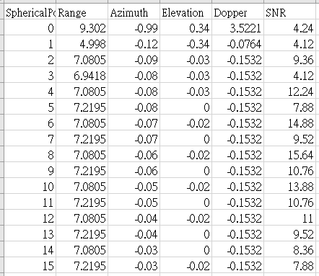
Point Cloud Mapping
Raw output data are represented in polar coordinates.
The angular resolution is 0.01 radians
Both Elevation and Azimuth
Doppler

Slide 24
MMWave Resolution
Elevation ranges from -0.34 to 0.34 radian (-19.48° to 19.48°)
The missing angles include -0.32, ±0.25, ±0.23, ±0.18, ±0.16, ±0.13, ±0.11, ±0.04, and ±0.01 radian
Azimuth ranges from -1.28 to 1.27 radian (-73.338° to 72.766°)
No missing angle

Slide 25

MMWave Resolution
We can use elevation and azimuth to generate a 69 pixels * 256 pixels image
This image is generated by accumulating point cloud, not real-time point cloud
Notes:
越近越紅

Slide 26
Point Cloud Mapping
Raw output data are represented in polar coordinates.
The angular resolution is 0.01 radians
Both Elevation and Azimuth
Choose closer point
Doppler

Slide 27
Methodology
Point Cloud Mapping
2D Heat map De-noising
HDBSCAN Cluster Optimization
Regression Calibration
Tracker

Slide 28
Methodology
TCP/IP: Transmission Control Protocol / Internet Protocol
Current System Flow Chart
Raw Point Cloud
(Polar Coordinates)
Point Cloud
(Cartesian Coordinates)
mmWave
Coordinate Transformation
and Filter by Depth Z
HDBSCAN
Demonstration through Unity
Raw Point Cloud
(Polar Coordinates)
2D Heat Map
(elevation*azimuth)
(value is range)
Points Position
(Cartesian Coordinates)
TCP/IP
Connection
2D Heat Map
(elevation*azimuth)
(value is range)
Point Cloud Mapping
De-noising
Regression Calibration
Tracker

Slide 29
2D Heat Map De-noising
Dual-track denoising: one is binary image, other is gray-level image
Binary image: pixel = 255 if there is any point in this pixel
Gray-level image: pixel = 255 * (range_of_point - 0) / (300 - 0)
Do Dilation first and then do Erosion to complement the lack of pixel
Manipulate two images separately
Closing Operation Complement
Median Blur
Binary Heat Map
Median Blur
Median Blur
Integrate
Denoised Heat Map
Heat Map
Closing Operation Complement
Grayscale Heat Map
Median Blur

Slide 30
Median Blur
Do median blur on binary image three times for de-noise
Do median blur on gray-level image one time for pixel value expansion
After blurring
If pixel = 0 in binary image, set pixel = 0 in gray-level image
Else pixel in gray-level image does not change
Closing Operation Complement
Median Blur
Binary Heat Map
Median Blur
Median Blur
Integrate
Denoised Heat Map
Heat Map
Closing Operation Complement
Grayscale Heat Map
Median Blur

Slide 31
Methodology
TCP/IP: Transmission Control Protocol / Internet Protocol
Current System Flow Chart
Raw Point Cloud
(Polar Coordinates)
Point Cloud
(Cartesian Coordinates)
mmWave
Coordinate Transformation
and Filter by Depth Z
HDBSCAN
Demonstration through Unity
Raw Point Cloud
(Polar Coordinates)
2D Heat Map
(elevation*azimuth)
(value is range)
Points Position
(Cartesian Coordinates)
TCP/IP
Connection
2D Heat Map
(elevation*azimuth)
(value is range)
Point Cloud Mapping
De-noising
Regression Calibration
Tracker

Slide 32
Coordinate Transformation
Why coordinate transformation?
Because there is no feature in heat map about distance to wall
Do coordinate transformation after de-noising
Select the point with Z in the range [-10 cm : 50 cm]
Notes:
為啥設-10:40 因為設最小:最小+15 會使點雲看起來不太順
若有出現z超級小的點，會讓正常揮動的手都顯示不出來

Slide 33
Methodology
Point Cloud Mapping
2D Heat map De-noising
HDBSCAN Cluster Optimization
Regression Calibration
Tracker

Slide 34
Methodology
TCP/IP: Transmission Control Protocol / Internet Protocol
Current System Flow Chart
Raw Point Cloud
(Polar Coordinates)
Point Cloud
(Cartesian Coordinates)
mmWave
Coordinate Transformation
and Filter by Depth Z
HDBSCAN
Demonstration through Unity
Raw Point Cloud
(Polar Coordinates)
2D Heat Map
(elevation*azimuth)
(value is range)
Points Position
(Cartesian Coordinates)
TCP/IP
Connection
2D Heat Map
(elevation*azimuth)
(value is range)
Point Cloud Mapping
De-noising
Regression Calibration
Tracker

Slide 35
HDBSCAN Cluster Optimization
RMSE: Root Mean Squared Error
Sample-wise RMSE between hand point and dummy nodes
Dimension-wise RMSE between hand point and dummy nodes
Dataset size
Represents clustering quality
Approximately totally almost 57,000 corresponding hand-dummy pairs would be more reasonable
RMSE
Consider all points clustered by HDBSCAN
Minimize RMSE

Slide 36
HDBSCAN Cluster Optimization
Tunable hyper-parameters
HDBSCAN parameters
min_cluster_size: 5 to 50, step = 5
min_samples: same as min_cluster_size
With or without cluster_epsilon: 0 cm to 35 cm, step = 5 cm
persistent_frame: 1 to 7 (Overlapping sliding windows)
A consistent or stable frame maintained throughout a sequence, ensuring continuous tracking or reference
Temporal smoothing
Exhaustively searching parameters Before Regression within range (1,500 mins, Intel i7)

Slide 37
Methodology
Point Cloud Mapping
2D Heat map De-noising
HDBSCAN Cluster Optimization
Regression Calibration
Tracker

Slide 38
Methodology
TCP/IP: Transmission Control Protocol / Internet Protocol
Current System Flow Chart
Raw Point Cloud
(Polar Coordinates)
Point Cloud
(Cartesian Coordinates)
mmWave
Coordinate Transformation
and Filter by Depth Z
HDBSCAN
Demonstration through Unity
Raw Point Cloud
(Polar Coordinates)
2D Heat Map
(elevation*azimuth)
(value is range)
Points Position
(Cartesian Coordinates)
TCP/IP
Connection
2D Heat Map
(elevation*azimuth)
(value is range)
Point Cloud Mapping
De-noising
Regression Calibration
Tracker

Slide 39
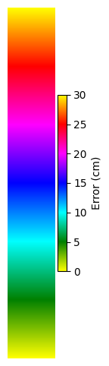
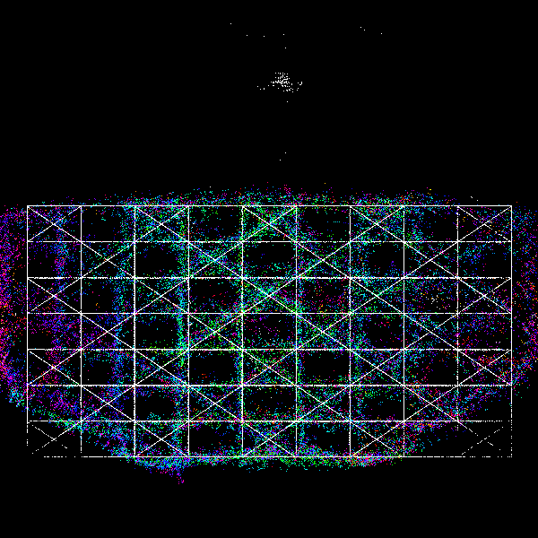
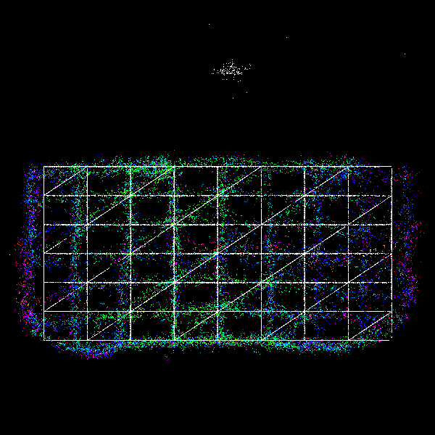
Regression Calibration
mmWave
Training Paths Testing Paths
mmWave

Slide 40
Regression Calibration
Data labeling
Data augmentation
Performance of regression model

Slide 41
Data Labeling
Choose the closest hand point to the dummy node within radius 25 cm to be a hand-dummy pair for each frame
Add that hand-dummy pair into dataset
Split all collected corresponding pairs into datasets with a ratio of 7 : 1.5 : 1.5

Slide 42
Data Augmentation
Data augmentation for Z-axis
LR Flip the training set on XY plane
Duplicate the training set on different Z depths
Interval: 1 cm
Augmentation range: ±3 cm for each collected data set
Dataset | Training set | Validation set | Testing set
Testing path | - | - | 25,273
Training path | 560,952 | 8,591 | 8,604
(pairs)

Slide 43
Methodology
TCP/IP: Transmission Control Protocol / Internet Protocol
Current System Flow Chart
Raw Point Cloud
(Polar Coordinates)
Point Cloud
(Cartesian Coordinates)
mmWave
Coordinate Transformation
and Filter by Depth Z
HDBSCAN
Demonstration through Unity
Raw Point Cloud
(Polar Coordinates)
2D Heat Map
(elevation*azimuth)
(value is range)
Points Position
(Cartesian Coordinates)
TCP/IP
Connection
2D Heat Map
(elevation*azimuth)
(value is range)
Point Cloud Mapping
De-noising
Regression Calibration
Tracker

Slide 44
Methodology
Point Cloud Mapping
2D Heat map De-noising
HDBSCAN Cluster Optimization
Regression Calibration
Tracker

Slide 45
Tracker
Kalman filter + Hungarian algorithm
Give hand IDs
Parameter
History frame
Press threshold
Use past location (25 frames) to generate motion signals
Press
Pull

Slide 46
Experimental Results
RMSE: Root Mean Squared Error
HDBSCAN Cluster Optimization
Video

Slide 47
HDBSCAN Cluster Optimization
Method MD
With Mapping and Denoising
mmWave → Point mapping → Denoising → Coordinate Transformation and Filter → HDBSCAN → Regression model Calibration → Unity
Method XMD
Points directly from original point cloud (No Mapping nor Denoising)
mmWave → Coordinate Transformation and Filter → HDBSCAN → Regression model Calibration → Unity

Slide 48
HDBSCAN Cluster Optimization
RMSE: Root Mean Squared Error
p_frame: persistent frame
c_size: min_cluster_size
eps: cluster_epsilon
Method |  | MD | XMD | XMD
Parameters | Persistent Frame | 4 | 6 | 4
 | Min Cluster Size | 5 | 15 | 5
 | Cluster Epsilon | 30 cm | 15 cm | 30 cm
Sample-wise RMSE (cm) |  | 14.359 cm | 14.657 cm | 14.899 cm
Dimension-wise RMSE (cm) | X-axis | 7.647 cm | 8.9356cm | 9.187 cm
 | Y-axis | 5.90 cm | 5.612 cm | 5.997 cm
 | Z-axis | 10.625 cm | 10.174 cm | 10.080 cm
Dataset Size (# of hand-dummy pairs) |  | 57,263 | 57,210 | 91,565

Slide 49
Conclusion and Future Works
The establishment of evaluation standards for interactive wall systems
Both temporal and spatial measurement metrics
Develop a precise quantification algorithm for wireless connection latency temporally
Ensure the reliability of data collection and analysis
Establish interactive positioning accuracy measurement methodologies spatially
Enable real-time monitoring of sensor coordinate errors to facilitate subsequent system performance evaluation and analysis

Slide 50
Conclusion and Future Works
The issue of ID misalignment during single-sensor tracking
Tracking stability requires further enhancement
While demonstrate superior tracking precision compared with traditional people counting algorithms
Explore multi-sensor integration
Develop more sophisticated tracking algorithms
Utilize both localization and recognition techniques for hand motion

Slide 51
3D Millimeter-Wave Gesture Localization for Wall-Based Interactive System
Methods
2D Heat map
Clustering
Multi-Object Tracking
1. Acquire and Preprocess mmWave Raw Data
2. Use HDBSCAN to cluster and optimize hand localization.
3. Use Kalman Filter and Hungarian Algorithm for hand tracking.
4. Transmit the processed results to Unity for real-time visualization.
Steps
Results
Find HDBSCAN Cluster Optimization(Method MD)
Implement gesture tracking functionality in Unity for interactiveapplications.

Slide 52
References
[1] J. Benesty, J. Chen, and Y. Huang, "A Generalized Mvdr Spectrum," IEEE Signal Processing Letters, Vol. 12, No. 12, pp. 827-830, 2005.
[2] A. Bewley, Z. Ge, L. Ott, F. Ramos, and B. Upcroft, "Simple Online and Realtime Tracking," Proceedings of IEEE International Conference on Image Processing, Phoenix, AZ, pp. 3464-3468, 2016.
[3] R. J. Campello, D. Moulavi, and J. Sander, "Density-Based Clustering Based on Hierarchical Density Estimates," Proceedings of Pacific-Asia Conference on Knowledge Discovery and Data Mining, Gold Coast, Australia, pp. 160-172, 2013.
[4] V. Cerf and R. Kahn, "A Protocol for Packet Network Intercommunication," IEEE Transactions on Communications, Vol. 22, No. 5, pp. 637-648, 1974.
[5] K. Date and R. Nagi, "GPU-Accelerated Hungarian Algorithms for the Linear Assignment Problem," Parallel Computing, Vol. 57, pp. 52-72, 2016.
[6] D. L. Davies and D. W. Bouldin, "A Cluster Separation Measure," IEEE Transactions on Pattern Analysis and Machine Intelligence, Vol. 1, No. 2, pp. 224-227, 1979.
[7] D. Eppstein, "Solving Single-Digit Sudoku Subproblems," Proceedings of International Conference on Fun with Algorithms, Venice, Italy, pp. 142-153, 2012.
[8] M. Ester, H.-P. Kriegel, J. Sander, and X. Xu, "A Density-Based Algorithm for Discovering Clusters in Large Spatial Databases with Noise," Proceedings of KDD, Vol. 96, No. 34, pp. 226-231, 1996.
[9] G. Evensen, "Sequential Data Assimilation with a Nonlinear Quasi‐Geostrophic Model Using Monte Carlo Methods to Forecast Error Statistics," Journal of Geophysical Research: Oceans, Vol. 99, No. C5, pp. 10143-10162, 1994.
[10] J. Y. Han, "Multi-Touch Interaction Wall," Proceedings of ACM SIGGraph Emerging Technologies, Boston, Massachusetts, pp. 25-es, 2006.
[11] J. Y. Han, "Low-Cost Multi-Touch Sensing through Frustrated Total Internal Reflection," Proceedings of Annual ACM Symposium on User Interface Software and Technology, Seattle, Washington, pp. 115-118, 2005.
[12] Y. Hong, H. Yoon, D. Jung, Y. Yoon, and Y. Seol, "Experiential Media Wall Utilizing Hand Gesture Recognition," Proceedings of International Conference on Information and Education Technology, Yamaguchi, Japan, pp. 387-391, 2024.

Slide 53
References
[13] S. J. Julier and J. K. Uhlmann, "New Extension of the Kalman Filter to Nonlinear Systems," Proceedings of Signal Processing, Sensor Fusion, and Target Recognition VI, Vol. 3068, pp. 182-193, 1997.
[14] R. E. Kalman, "A New Approach to Linear Filtering and Prediction Problems," Transactions of the ASME–Journal of Basic Engineering, Vol. 82 (Series D), pp. 35-45, 1960.
[15] R. E. Kalman and R. S. Bucy, "New Results in Linear Filtering and Prediction Theory," Transactions of the ASME–Journal of Basic Engineering, Vol. 83, No. 1, pp. 95-108, 1961.
[16] H. Kim and D. W. Fellner, "Interaction with Hand Gesture for a Back-Projection Wall," Proceedings of Computer Graphics International, Crete, Greece, pp. 395-402, 2004.
[17] H. W. Kuhn, "The Hungarian Method for the Assignment Problem," Naval Research Logistics Quarterly, Vol. 2, No. 1‐2, pp. 83-97, 1955.
[18] H. Liu et al., "Real-Time Arm Gesture Recognition in Smart Home Scenarios via Millimeter Wave Sensing," Proceedings of the ACM on Interactive, Mobile, Wearable and Ubiquitous Technologies, Vol. 4, No. 4, pp. 1-28, 2020.
[19] L. McInnes and J. Healy, "Accelerated Hierarchical Density Clustering," arXiv 1705.07321, 2017.
[20] L. McInnes, J. Healy, and S. Astels, "HDBSCAN: Hierarchical Density Based Clustering," J. Open Source Softw., Vol. 2, No. 11, p. 205, 2017.
[21] J. Munkres, "Algorithms for the Assignment and Transportation Problems," Journal of the Society for Industrial and Applied Mathematics, Vol. 5, No. 1, pp. 32-38, 1957.
[22] S. Palipana, D. Salami, L. A. Leiva, and S. Sigg, "Pantomime: Mid-Air Gesture Recognition with Sparse Millimeter-Wave Radar Point Clouds," Proceedings of the ACM on Interactive, Mobile, Wearable and Ubiquitous Technologies, Vol. 5, No. 1, pp. 1-27, 2021.
[23] C. R. Qi, L. Yi, H. Su, and L. J. Guibas, "Pointnet++: Deep Hierarchical Feature Learning on Point Sets in a Metric Space," Advances in Neural Information Processing Systems, Long Beach, CA, Vol. 30, pp. 5105-5114, 2017.
[24] I. S. Reed, R. M. Gagliardi, and L. B. Stotts, "A Recursive Moving-Target-Indication Algorithm for Optical Image Sequences," IEEE Transactions on Aerospace and Electronic Systems, Vol. 26, No. 3, pp. 434-440, 1990.

Slide 54
References
[25] S. D. Regani, C. Wu, B. Wang, M. Wu, and K. R. Liu, "Mmwrite: Passive Handwriting Tracking Using a Single Millimeter-Wave Radio," IEEE Internet of Things Journal, Vol. 8, No. 17, pp. 13291-13305, 2021.
[26] H. Rohling, "Radar Cfar Thresholding in Clutter and Multiple Target Situations," IEEE Transactions on Aerospace and Electronic Systems, No. 4, pp. 608-621, 1983.
[27] P. J. Rousseeuw, "Silhouettes: A Graphical Aid to the Interpretation and Validation of Cluster Analysis," Journal of Computational and Applied Mathematics, Vol. 20, pp. 53-65, 1987.
[28] S. F. Schmidt, "Application of State-Space Methods to Navigation Problems," Advances in Control Systems, Vol. 3, pp. 293-340, 1966.
[29] E. Schubert, J. Sander, M. Ester, H. P. Kriegel, and X. Xu, "DBSCAN Revisited, Revisited: Why and How You Should (Still) Use DBSCAN," ACM Transactions on Database Systems, Vol. 42, No. 3, pp. 1-21, 2017.
[30] A. Sengupta, F. Jin, R. Zhang, and S. Cao, "Mm-Pose: Real-Time Human Skeletal Posture Estimation Using Mmwave Radars and CNNs," IEEE Sensors Journal, Vol. 20, No. 17, pp. 10032-10044, 2020.
[31] B. Wang, Z. Sun, X. Jiang, J. Zeng, and R. Liu, "Kalman Filter and Its Application in Data Assimilation," Atmosphere, Vol. 14, No. 8, pp. 1319-1338, 2023.
[32] Z. Wang, D. Jiang, B. Sun, and Y. Wang, "A Data Augmentation Method for Human Activity Recognition Based on Mmwave Radar Point Cloud," IEEE Sensors Letters, Vol. 7, No. 5, pp. 1-4, 2023.
[33] R. Zahra et al., "Camera-Based Interactive Wall Display Using Hand Gesture Recognition," Intelligent Systems with Applications, Vol. 19, No. 200262, pp. 1-8, 2023.
[34] J. Zhang et al., "A Survey of Mmwave-Based Human Sensing: Technology, Platforms and Applications," IEEE Communications Surveys & Tutorials, Vol. 25, No. 4, pp. 2052-2087, 2023.
[35] Q. Zhu, L. Fan, and N. Weng, "Advancements in Point Cloud Data Augmentation for Deep Learning: A Survey," Pattern Recognition, Vol. 153, No. 110532, pp. 1-18, 2024.

